Slide 1
Caching, Scaling, and WordPress.com VIP
Erick Hitter
Boston WordPress Meetup, November 28

Slide 2
Why Should You Care About Anything I Have to Say?
Erick Hitter
Lead WordPress developer with Oomph!
@ethitter
http://www.ethitter.com
http://www.thinkoomph.com
Disclaimer: I started this in Google Docs, then had to switch to PowerPoint, which explains some of the wonky formatting.

Slide 3
Caching
Serving static content to a visitor rather than something generated upon request.
Two major types in WordPress context:
Page
Whole page is static and, therefore, could be outdated.
Fragment
Cache pieces of a page rather than the entire page.
Notes:
Page caching - WordPress.com defaults to five minute cache. WILL NOT be focus of discussion. Not generally used if users must log in.
Fragment caching - Not only does entire page not need to be cached, but pieces can be reused across many pages.

Slide 4
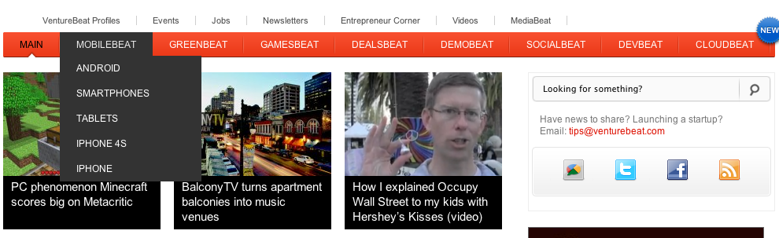
Fragment Caching Benefits
Allow dynamic and static content to coexist
Notes:
Semi-static menu, dynamic popular content area

Slide 5
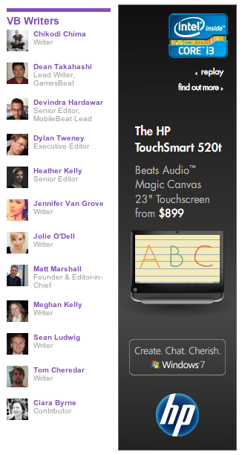
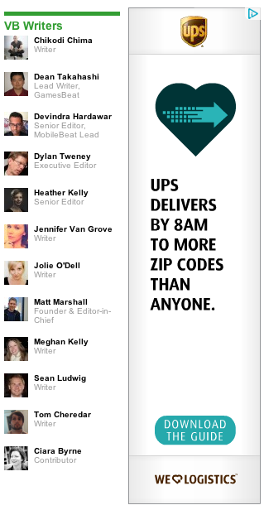
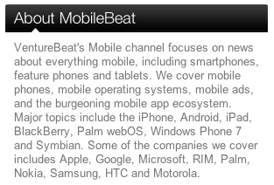

Fragment Caching Benefits
Common elements can be reused throughout a site
Notes:
About boxes used throughout a category, but are category-specific.
Writers list is static across site.

Slide 6
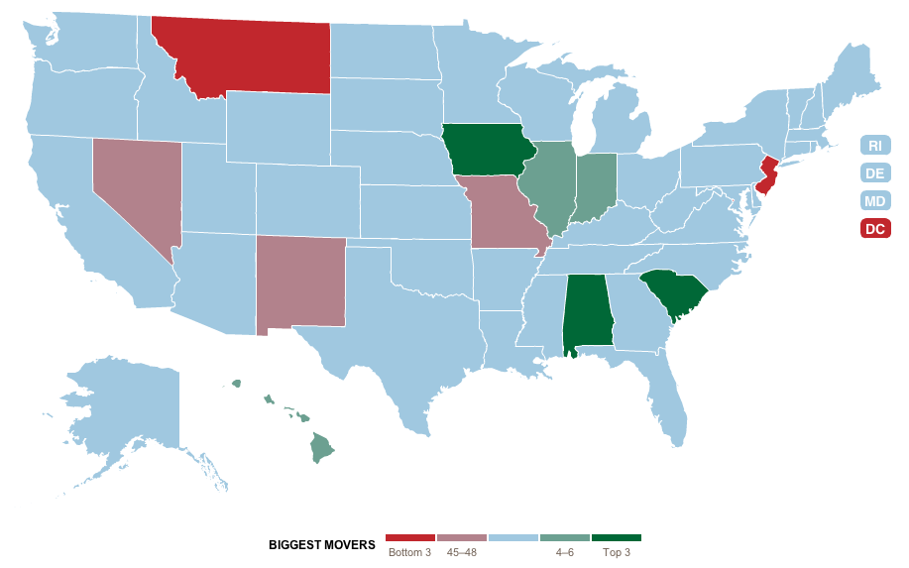
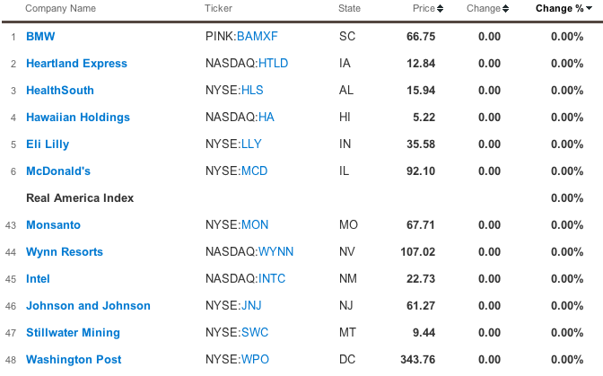
Fragment Caching Benefits
Reduce calls to APIs
Notes:
Reduce calls to APIs - potentially save money, reduce risk of slow-to-respond APIs delaying page load, increase page load speed for complex API calls.
49 API calls to render this page (1 for current prices, 48 for historical data [3 states's selections aren't publicly traded])

Slide 7
WordPress' Native Caching APIs
Transients
Persistent out of the box
Stored in wp_options: _transient_{key}
WordPress uses for certain internal functions
set_, get_, and delete_transient()
Object Cache
Not persistent without a plugin, such as W3 Total Cache
Storage depends on server's and plugin's capabilities
Used extensively within WordPress
Cache objects can be grouped
wp_cache_add(), _set, _get, _delete
Notes:
Both are fragment caching systems
Internal transient usage includes update checks and feed caching (RSS widgets, fetch_feed())
Examples will focus on object cache because it's preferred over transients on WordPress.com (doesn't write to DB)

Slide 8
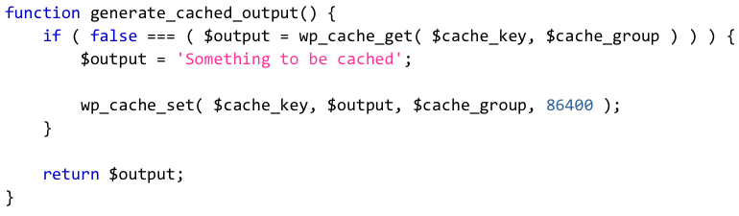
Fragment Caching Basics: Creating
wp_cache_get() returns a boolean false if the requested cache isn't set or has expired.
Everything that is to be cached must be accessible via a function that returns its results rather than echoing them, otherwise output buffering is needed.
wp_cache_add() will not overwrite an existing, unexpired cache, whereas wp_cache_set() does.
Notes:
WordPress.com doesn’t cache pages for logged-in users
WordPress functions such as the_content() have an underlying version get_the_content() that returns rather than echoes.

Slide 9
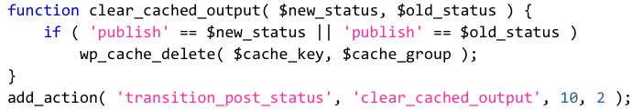
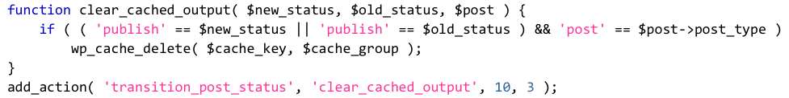
Fragment Caching Basics: Clearing
This above example clears a cache when anything is published or something that is published is modified. The "something" could be a post, page, or custom post type object.
If, instead, the cache should be rebuilt when the same event occurs, wp_cache_delete() could be replaced with generate_cached_output().

Slide 10
Unpredictable Keys
Object caching doesn’t provide a way to clear all caches in a given group.
Therefore, if the cache key is unpredictable, how can we clear it?
For example, a list of recent posts to be displayed on an individual post, but that excludes the current post.

Slide 11
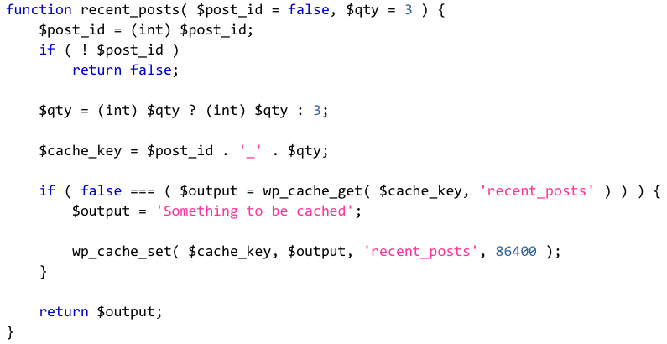
Unpredictable Keys: Recent Posts
Notes:
To clear, must know both post ID and quantity originally requested.

Slide 12
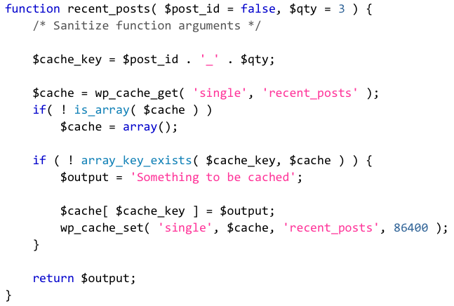
Unpredictable Keys: Cached Array

Slide 13
Unpredictable Keys: Cached Array
Pros
Cache can easily be cleared because a single object with a predictable key is set.
Cache is only rebuilt if specific post ID/quantity key is absent from array.
Better for cache elements that are reliably small.
Allows for checking existence of various keys, such as in a loop.
Cons
Object caching configuration may limit size of individual cache objects.
Array corruption could invalidate an entire cache object.
Array can become bloated if different quantities are used simultaneously.
Notes:
WordPress.com permits caches no larger than 1MB.
Array of related posts for site with lots of content can exceed that easily.
For VentureBeat, certain ad options are cached into an array so that a default can be provided.

Slide 14
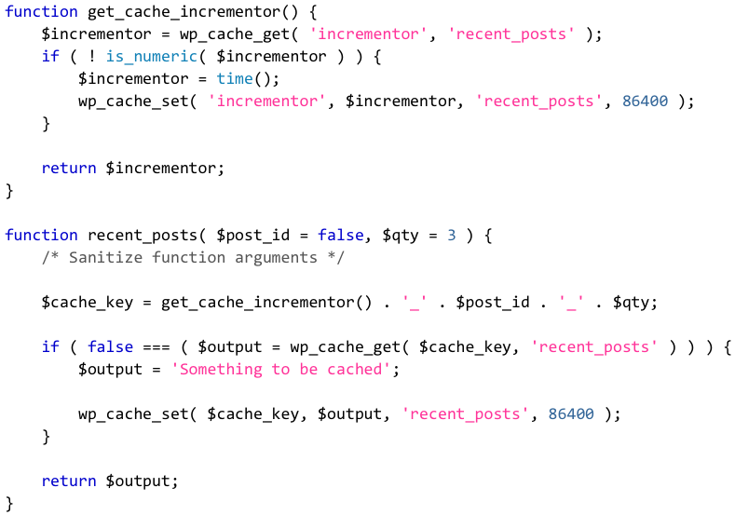
Unpredictable Keys: Incrementor
Notes:
Overcomes the limitations of array cache object
Deleting incrementor invalidates any existing caches, which will be pushed out of the object cache over time.

Slide 15
Where We Use Fragment Caching
Custom loops
Anytime a lot of data must be retrieved from WordPress and parsed.
Most situations where WP_Query generates a subquery outside of the main query.
Almost anything that is reused across multiple pages.
Notes:
Custom loops – InvestorPlace Press Center
Data retrieval – CACHE WRAPPERS FOR WORDPRESS FUNCTIONS
- term data, including term objects and, especially, term relationships
- large blocks of post meta
- certain uses of user meta
- show VentureBeat/functions/misc.php lines 1432 - 1488
Subqueries – excluding taxonomy terms. Will cache data that subquery produces and pass through post__not_in or post__in when possible.
Reusable – widgets, menus, common header or footer elements (VentureBeat)

Slide 16

category__not_in vs post__not_in
SELECT … WHERE 1=1 AND wp_posts.ID NOT IN (
SELECT tr.object_id FROM wp_term_relationships AS tr INNER JOIN wp_term_taxonomy AS tt ON tr.term_taxonomy_id = tt.term_taxonomy_id WHERE tt.taxonomy = 'category' AND tt.term_id IN ('167') ) …

Slide 17
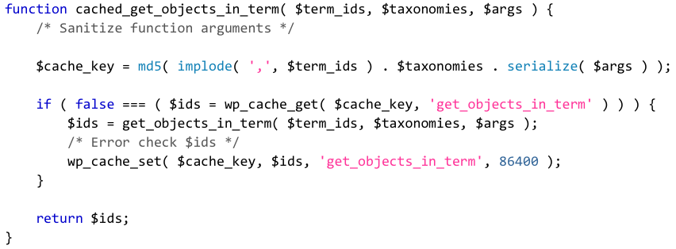
category__not_in vs post__not_in

Slide 18

category__not_in vs post__not_in
SELECT … WHERE 1=1 AND wp_posts.ID NOT IN (
SELECT tr.object_id FROM wp_term_relationships AS tr INNER JOIN wp_term_taxonomy AS tt ON tr.term_taxonomy_id = tt.term_taxonomy_id WHERE tt.taxonomy = 'category' AND tt.term_id IN ('167') ) …
SELECT … WHERE 1=1 AND wp_posts.ID NOT IN (
'1','2','3','4','5' ) …
Notes:
Eliminates subquery and its two joins
Dropped execution time from roughly 45ms to 30ms.
Caching imparts additional performance increase

Slide 19
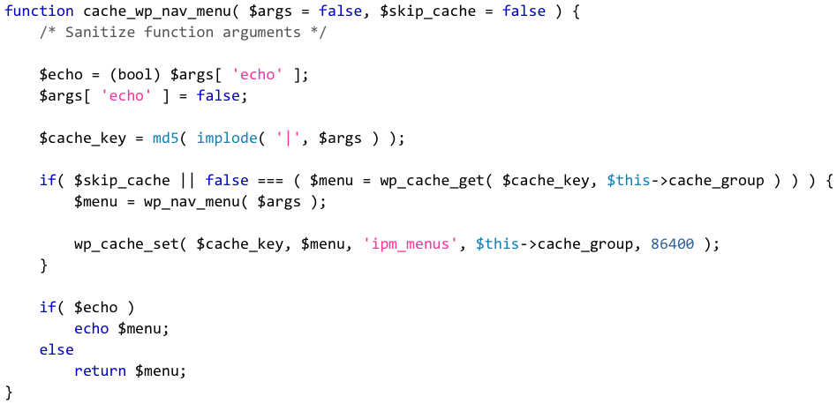
Menu Caching: No Active States
Notes:
Menu items exist as objects in wp_posts table, organized by the nav_menu taxonomy.
Since menu items are in a taxonomy, all taxonomy tables must be joined to posts table to retrieve menu items.
If active menu states are unnecessary, the output or wp_nav_menu() can be cached directly.

Slide 20
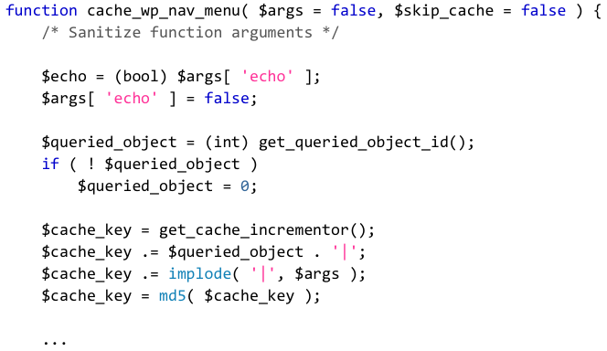
Menu Caching: Active States

Slide 21
Menu Caching: Keys & Clearing
get_queried_object_id() returns an integer representing the post ID or term ID.
Front page and custom post type archives return 0.
Menu caches must be cleared when four different actions fire to ensure consistency:
wp_update_nav_menu
wp_update_nav_menu_item
wp_delete_nav_menu
wp_setup_nav_menu_item
Notes:
If using custom post types, must create own unique identifier
Can add previously-discussed cache incrementor if invalidation is necessary.

Slide 22

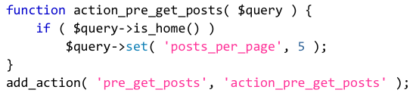
query_posts() vs pre_get_posts
query_posts()
Function provided to modify main query.
Runs after main query has already executed.
pre_get_posts
Action used to modify any query.
Runs before every query executes.
Notes:
query_posts() discards a query without using it, then runs a new query. Unnecessarily inefficient.
Not intended for creating new loops.

Slide 23
How Does This Factor Into Our Work On WordPress.com VIP?
Page caches only last for five minutes.
No page caching for logged-in users.
Sites that publish with great frequency trigger regular invalidations of homepage and category pages.
Web servers outnumber database servers.
Want to know more about WordPress.com infrastructure? Check out http://goo.gl/lYpJH.
Notes:
First three in context of fragment caching for complex items such as VB menus and footer elements
Web servers in context of reducing subqueries
WordPress.com infrastructure
1,500+ servers in 3 data centers
25 million sites
2 petabytes of storage
100% using nginx
Batcache for page caching
Memcached for object caching
Almost all database and caching servers use SSDs.

Slide 24
Questions?
erick@thinkoomph.com
@ethitter
http://www.slideshare.net/ethitter

